Slide 1
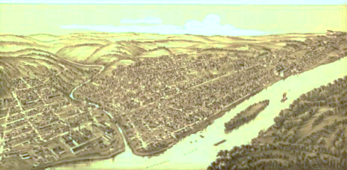
Who Knew!
Audubon Society of Western Pennsylvania
Tuesday June 18 at 6 PM
Wednesday June 19 at 6 PM
Registration Required at 724-226-0770

