Slide 1
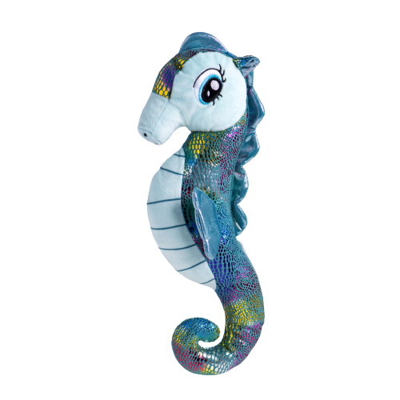
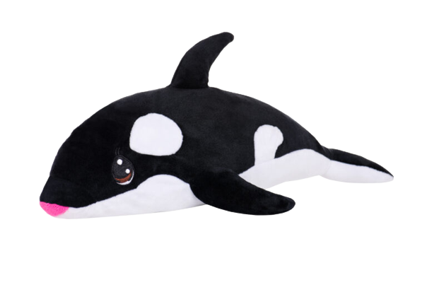
Friday, July 29 at 1:30PM
Build A Buddy!
$20 Each
Must be pre-paid on line
Sheldon the Sea Horse Biddy Squiddy
Willie the Whale Tellie Turtle Halsey the Flamingo

